Slide 1

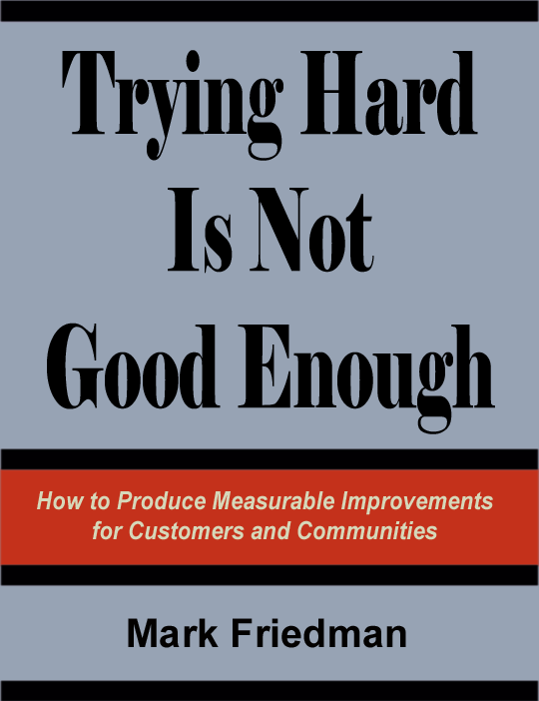

Übersetzungsentwurf freundlicherweise durch Ilka Meisel (http://www.wirtschaft.nrw.de) , Annika Schmitt(http://www.linkwest.asn.au) und Sabine Stölb (http://www.dat.public.lu)
EOV
Ergebnisorientierte Verantwortlichkeit
Results Based Accountability – RBA TM
Institut für Finanzpolitische Studien
www.raguide.org www.resultsaccountability.com
Buch – DVD Bestellung
amazon.com
resultsleadership.org
Notes:
Introduction and the difference between population and performance accountability: We are going to talk about two different kinds of accountability: Accountability for whole populations, like all children in Los Angeles, all elders in Chicago, all residents of North Carolina. This first kind of accountability is not the responsibility of any one agency or program. If we talk for example about “all children in your community being healthy,” who are some of the partners that have a role to play? Notice that the traditional answer is “It’s the health department.” It’s got the word health in it and so it must be the responsibility of the health department. And yet one of the things we have learned in the last 50 years is that the health department by itself can’t possibly produce health for all children without the active participation of many other partners. And that’s the nature of this first kind of accountability. It’s not about the health department. It’s about the kind of cross community partnerships necessary to make progress on quality of life for any population. Now the second kind of accountability, Performance Accountability, is about the health department. It’s about the programs and services we provide, and our role as managers, making sure our programs are working as well as possible. These are two profoundly different kinds of accountability. We going to talk about how to do each one well and then how they fit back together again.

Slide 2
EINFACH
GESUNDER MENSCHENVERSTAND
EINFACHE SPRACHE
MINIMUM PAPIER
NÜTZLICH
Notes:
These are criteria you should apply to any planning or management system you are considering. Most past efforts have been big paper exercise wastes of time. It is possible to do this work in a way that is simple, common sense, plain language, minimum paper and most importantly useful. Results and performance accountability is one approach that meets these tests.

Slide 3
Ergebnisorientierte Verantwortlichkeit besteht aus zwei Teilen:
Bevölkerungsergebnis
hinsichtlich des Wohls der
GESAMTEN BEVÖLKERUNG
Für Gemeinschaften – Städte – Regionen– Länder
Leistungsergebnis
hinsichtlich des Wohls einer SPEZIELLEN ZIELGRUPPE
Für Programme – Agenturen/z.B. Entwicklungsgesellschaften - Dienstleister PRR
Notes:
Introduction and the difference between population and performance accountability: We are going to talk about two different kinds of accountability: Accountability for whole populations, like all children in Los Angeles, all elders in Chicago, all residents of North Carolina. This first kind of accountability is not the responsibility of any one agency or program. If we talk for example about “all children in your community being healthy,” who are some of the partners that have a role to play? Notice that the traditional answer is “It’s the health department.” It’s got the word health in it and so it must be the responsibility of the health department. And yet one of the things we have learned in the last 50 years is that the health department by itself can’t possibly produce health for all children without the active participation of many other partners. And that’s the nature of this first kind of accountability. It’s not about the health department. It’s about the kind of cross community partnerships necessary to make progress on quality of life for any population. Now the second kind of accountability, Performance Accountability, is about the health department. It’s about the programs and services we provide, and our role as managers, making sure our programs are working as well as possible. These are two profoundly different kinds of accountability. We going to talk about how to do each one well and then how they fit back together again.

Slide 4
Ergebnisorientierte Verantwortlichkeit
GEMEINSAME SPRACHE
GEMEINSAMES VERSTÄNDNIS
GEMEINSAME BASIS
Notes:
Common Language, Common Sense, Common Ground: Here’s another way of thinking about what we’re going to talk about today: Common Language, Common Sense and Common Ground. We’re going to start with Common Language, because the truth of the matter is that it’s a Tower of Babel out there. People are using words in so many different ways. So we’ll start with common language. Common Sense is about the way the rest of the world works. If you look at any serious successful enterprise…. Business is always held up as the way we should model our behavior…. But look at any of the…. Business, the military, the sports world, the faith community. Any successful enterprise starts with ends and works backwards to means. And Common Ground is about the political nature of this work. And all of this, from first word to last, is political in one way or another. This is not necessarily bad. Politics is how we make decisions. But look at the political system, national, state or local and what do you see? People fighting with each other. But look at what they’re fighting about… and more often than not they’re fighting about means and not ends. There’s remarkable agreement that teen pregnancy is bad for our young people. Now we fight about whether to preach abstinence or hand out condoms. But this is a means debate. The agreement about teen pregnancy is remarkably broadly based. And when you begin to articulate what it is we want for children, families, community in plain language. We want children to be born healthy, be ready for school, succeed in school, grow up to be productive, happy contributing adults. We want to live in safe communities with a clean environment. When you begin to say things in plain language like that, it turns out that these kinds of statements are not Republican vs. Democrat. They’re not state vs. local. They’re not executive branch vs. legislative branch. They represent a kind of common ground, where people can come together and say “Yes, those are the conditions we’d like to be able to say exist here.” Now let’s have a healthy debate about the means to get there.

Slide 5
Die Tücken der Sprache
Zu viele Begriffe. Zu wenige Definitionen. Zu wenig Disziplin
Referenzwert
Ergebnis
Resultat
Modifikatoren
messbar Kern
eilig qualitativ
Priorität programmatisch
gezielt Leistung
schrittweise strategisch
systemisch
Indikator
Ziel
Maßnahme
Zielsetzung
Zielpunkt
Messbare dringende Systemindikatoren
Lewis Carroll Center for Language Disorders
Notes:
The Language Trap: Now you’ve seen all these words before. Read the outer ring of words. And then you get these modifiers in the middle. Read some or all of the inner ring of words. This page is the Jargon Construction Kit. If you want to sound fancy about this work, just pick three or four words off this page at random and string them together. Give example: “Measurable urgent systemic indicators,” whatever the hell that means. And I guarantee you’ll get away with it too, because people will be too embarrassed to ask you what you mean. I have a new rule, that anyone who uses three or more of these words in the same sentence doesn’t know what they’re talking about. It’s very common for two people to be in the same meeting using the same word. They have two entirely different ideas of what that word means, and they’re just talking right past each other. Has this ever happened to you?

Slide 6
DEFINITIONEN
RESULTAT oder ERGEBNIS
Eine Bedingung für das Wohl von
Kindern, Erwachsenen, Familien oder Gemeinschaften.
Gesund geborene Kinder,
schulreife Kinder,
sichere Gemeinschaften ,
saubere Umwelt,
florierende Wirtschaft
Population
Bevölkerung
INDIKATOR oder Referenzwert
Ein Wert welcher hilft, die erreichten Ergebnisse zu messen.
Anteil untergewichtiger Neugeborener,
Prozentsatz schulreifer Kinder,
Kriminalitätsrate,
Luftqualität,
Arbeitslosenquote
LEISTUNGBESMESSUNG
Eine Maßeinheit, die bemisst, wie gut ein Programm, eine Agentur, ein Dienstleister funktioniert.
Drei Arten
Performance
Performance
Leistung
1. Wieviel haben wir geleistet?
2. Wie gut haben wir das gemacht?
3. Was hat sich verbessert?
= Zielgruppen Ergebnisse
Notes:
So what we did a few years ago is develop a set of definitions that would allow us to have a disciplined conversation about this very complex work we’re trying to do. Now the purpose of these definitions is not to impose words on people. Words like “result” or “outcome” are just labels for ideas. If you think about if for a minute, that’s what words are, labels for ideas. And the same idea can have many different labels. What’s important here are not the labels. You can pick whatever labels you like. What important are the ideas, and that we manage to keep three ideas separate at the beginning of this work. Read the ideas and the examples for Results and Indicators.
Now this last category, performance measures…. Are measures of how well a program, agency or service system is working. Now there are many different ways to categorize performance measures, but I believe that all performance measures can be categorized into one of these three categories: How much did we do? How well did we do it? Is anyone better off? And this last category we sometimes call “customer results” or “customer outcomes.”
And if you do nothing else in terms of your language convention, I would strongly encourage you…. That whenever you want to use a word like “outcome” or “result” and you’re talking about a program or agency, put a modifier in front of it. Call if “program results” or “client outcomes,” something to distinguish it from the use of the words results and outcome to mean the whole population. This is the single biggest source of language confusion in the U.S. today.
The Language of Accountability
From www.raguide.org
The most common problem in this work is the problem of language. People come to the table from many different disciplines and many different walks of life. And the way in which we talk about programs, services and populations varies, literally, all over the map. This means that the usual state of affairs in planning for children, families, adults, elders and communities is a Tower of Babel, where no one really knows what the other person is saying, but everyone politely pretends that they do. As a consequence, the work is slow, frustrating and often ineffective.
It is possible to exercise language discipline in this work. And the way to do this is to agree on a set of definitions that start with ideas and not words.
Words are just labels for ideas. And the same idea can have many different labels. The following four ideas are the basis for definitions used at the beginning of this work. Alternative labels are offered:
Results (or outcomes or goals) are conditions of well-being for children, adults, families or communities, stated in plain English (or plain Spanish, or plain Korean...). They are things that voters and taxpayers can understand. They are not about programs or agencies or government jargon. Results include: "healthy children, children ready for school, children succeeding in school, children staying out of trouble, strong families, elders living with dignity in setting they prefer, safe communities, a healthy clean environment, a prosperous economy." (An interesting alternative definition of a result is provided by Con Hogan: "A condition of well-being for people in a place - stated as a complete sentence." This suggests a type of construction for a result statement as "All ______ in ______ are _____." e.g. All babies in Vermont are born healthy.")
Indicators (or benchmarks) are measures which help quantify the achievement of a result. They answer the question "How would we recognize these results in measurable terms if we fell over them?" So, for example, the rate of low-birthweight babies helps quantify whether we're getting healthy births or not. Third grade reading scores help quantify whether children are succeeding in school today, and whether they were ready for school three years ago. The crime rate helps quantify whether we are living in safe communities, etc.
Strategies are coherent collections of actions which have a reasoned chance of improving results. Strategies are made up of our best thinking about what works, and include the contributions of many partners. No single action by any one agency can create the improved results we want and need.
Performance Measures are measures of how well public and private programs and agencies are working. The most important performance measures tell us whether the clients or customers of the service are better off. We sometimes refer to these measures as client or customer results (to distinguish them from cross-community population results for all children, adults or families). It is sometimes useful to distinguish "program performance measures," from "agency performance measures" from "service system performance measures."
The principal distinction here is between ends and means. Results and indicators are about the ends we want for children and families. And strategies and performance measures are about the means to get there. Processes that fail to make these crucial distinctions often mix up ends and means. And such processes tend to get mired in the all-talk-no-action circles that have disillusioned countless participants in past efforts. You actually have choices about which labels to use in your work. And clarity about language at the start will help you take your work from talk to action.
What Mission and Vision, Values, Goals, Objectives, Problems, Issues
Inputs and Outputs?
Many of us have grown up with these traditional words in strategic planning and budgeting. Where do they fit?
First, remember that words are just labels for ideas. These seven words have no natural standard definition that bridges across all the different ways they are used. They are terms of art which can and are used to label many different ideas. This is why we pay so much attention to getting language discipline straight at the very beginning. It's the ideas that are important not the words. So you can choose to label the ideas in this guide with any words you like, provided you are consistent.
The word "mission" is usually used in relation to an organization, agency, program, initiative or effort. It is therefore mostly used in connection with agency or program performance accountability. Mission statements are usually concise statements of the purpose of an organization, sometimes also telling why and how the organization does what it does. Mission statements can be useful tools in communicating with internal and external stakeholders. It is possible to construct a mission statement from the performance measurement ideas in the upper right ("How well did we deliver service?") and lower right ("Is anyone better off?") quadrants of the performance measurement framework: For example: "Our mission is to help our clients become self sufficient ("Is anyone better off?" lower right) by providing timely, family friendly, culturally competent job training services ("How well did we deliver service?" upper right)." One mistake that is often made is that organizations spend months and sometimes years trying to craft the perfect mission statement before any other work can proceed. In the FPSI framework, mission statements are set aside, allowing the work of identifying and using performance measures to proceed quickly. Then, on a parallel track a small group can, if it is useful, use the work of the performance measurement groups to craft a workable mission statement.
The word "vision" is often used to convey a picture of a desired future, often one that is hard but possible to attain. This is a powerful idea. And in fact one can think of the set of desired results for children and families as one way of articulating such a vision. "We want our community to be one which is safe and supportive, where all children are healthy and ready for school, where all children succeed in school, and grow up to be productive and contributing adults." This is an example of a vision statement made up of desired results or ends. It is possible to craft such a statement before or after the development of results.
The word "values" in some ways defies definition. It is about what we hold most dear, how we view right and wrong, how we believe we should act, and how those beliefs are, in fact, reflected in our actions. Our values underlie all of the work we do. And that is nowhere more true than in the work on the well-being of children, families and communities. Our values will guide our choice of results for children and families and the decisions we make about how we and our partners take action to improve those results.
The word "goal" is often used interchangeably with "result and outcome" to label the idea of a condition of well-being for children, adults, families or communities (as in the case of Georgia, Missouri and Oregon for example). The word goal has many other common usages as well. It often serves as an all-purpose term to describe a desired accomplishment. "My goal for this month is to fix the roof." "Our goal is to increase citizen participation in the planning process." " The primary goal of the child welfare system is to keep children safe." and so forth. The word goal (or target) is sometimes used to describe the desired future level of achievement for an indicator or performance measure. "Our goal is 95% high school graduation in 5 years." "Our goal is to improve police response time to under 3 minutes." These are widely different usages. Still another use of the word "goal" is in relation to an implementation plan. Given a strategy and action plan to improve a particular result (children ready for school for example), it is possible to structure the action plan as a series of planned accomplishments (goals) with timetables and assigned implementation responsibility. For example, a goal in a "children ready for school plan" might be to "increase funding for child care by 25% this year and 50% next year." This is a specific action which will contribute to achieving the result. There is nothing wrong with any of these usages, provided they are clearly distinguished, used consistently and do not confuse the underlying concepts labeled results, indicators, strategies and performance measures discussed above.
The word "objective" is often paired with the word goal to specify what amount to a series of "subgoals" required to achieve the "higher" goal. The set of terms "mission, goal and objective" have a long history in the military to describe the strategic and tactical components of a large or small action or engagement. And some of their usage in the business sector and the public and private service sector derives from this history. In this framework, the terms goal and objective are most often used to structure the action plan and specify who will do what, how, and by when.
The words "problem" and "issue" are used in more ways that just about any planning term. They can be used to describe almost anything. "The problem with this computer is that the keyboard is too small." "The problem with our community is that there is not a safe place for children to play." "We must solve the issue of affordability if we are to provide child care for all who need it." These are three different uses of the words and there are countless others. Again, there is nothing wrong with any of these usages, provided that they do not interfere with the language discipline discussed above about ends and means.
The words "input" and "output" are commonly used categories for performance measures. There is no standard usage. The word "input" is most often used to describe the staff and financial resources which serve to generate "outputs." "Outputs" are most often units of service.
Change Agent vs. Industrial Models: Much of the tradition of performance measurement comes from the private sector and in particular the industrial part of the private sector. Work measurement - dating back to the time and motion studies of the late 19th and early 20th centuries - looked at how to improve production. Industrial processes turn raw materials into finished products. The raw materials are the inputs; the finished products are the outputs.
This model does not translate very well to public or private sector enterprises which provide services. It does not make much sense to think of clients, workers and office equipment as inputs to the service sausage machine, churning out satisfied, cured or fixed clients. Instead we need to begin thinking about services in terms of the change agent model. In this model, the agency or program provides services which act upon the environment to produce demonstrable changes in the well-being of clients, families, or communities. If the input/output language is maintained, then providing service is the input, change in customers' lives is the output.
One common situation illustrates the problems which arise when industrial model thinking is applied to services. It is the belief that the number of clients served is an output. ("We have assembled all these workers in all this office space; and we are in the business of processing unserved clients into served clients.") This misapplication of industrial performance concepts to services captures much of what is wrong with the way we measure human service performance today. "Number of clients served" is not an output. It is an input, an action which should lead to a change in client or social conditions - the real output we're looking for. ("We served 100 clients - input - and 50 of them got jobs - output - and 40 of them still had jobs a year later - even more important output.") This is a whole different frame of mind and a whole different approach to performance measurement.
A closely related industrial model problem involves treating dollars spent as inputs, and clients served as outputs. In this distorted view, dollars are raw materials, and whatever the program happens to do with those dollars are outputs. It's easy to see why this over-simplification fails to meet the public's need for accountability. In this construct, the mere fact that the government spent all the money it received is a type of performance measurement. This is surely a form of intellectual, and perhaps literal, bankruptcy. In this perverse scheme, almost all the agency's data is purportedly about outputs. This gives the agency the appearance of being output-oriented and very progressive. It just doesn't happen to mean anything.
Much of the confusion about performance measurement derives from the attempt to impose industrial model concepts on change agent services. The best model would be one which could span industrial and change agent applications. Some government services still involve industrial-type production (although these are often the best candidates for privatization and a diminishing breed.) In other cases, discussed below, the service itself, or components of the service, have product-like characteristics and industrial model concepts apply well. But most government and private sector human services fall into the change agent category. The approach to performance measurement described in this website can be used for either industrial or change agent applications. (Excerpt from "A Guide to Developing and Using Performance Measures, Finance Project, 1997)

Slide 7
BEVÖLKERNGS-
VERANTWORTLICHKEIT
Für gesamte Bevölkerungen
in einem geographischen Raum

Slide 8
Gemeinschaftsergebnisse
für Christchurch, NZ
● Eine sichere Stadt
● Eine Stadt mit inklusiven und vielfältigen Gemeinschaften
● Eine Stadt mit Menschen, die die natürliche Umwelt
wertschätzen und schützen
● Eine gut verwaltete Stadt
● Eine wohlhabende Stadt
● Eine gesunde Stadt
● Eine Stadt für Erholung, Spaß und Kreativität
● Eine Stad des lebenslangen Lernens
● Eine attraktive und gut gestaltete Stadt

Slide 9
Jedes Kind zählt– Jugendgesetz
Ergebnisse für Kinder und Jugendliche
Gesund sein: sich einer guten physischen und psychischen Gesundheit erfreuen und einen gesunden Lebenstil führen.
In Sicherheit sein: vor Leid und Vernachlässigung geschützt sein und in Selbständigkeit aufwachsen.
Freude haben und etwas erreichen: das Beste vom Leben bekommen und umfassende Fähigkeiten für das Erwachsensein entwickeln.
Einen positiven Beitrag leisten: für die Gemeinschaft und die Gesellschaft und kein unsoziales und anstößiges Verhalten an den Tag legen.
Wirtschaftliches Wohlergehen: sozio-ökonomische Nachteile überwinden, damit sie ihr maximales Potential im Leben erreichen können.

Slide 10
Die Stadt London
Ontario, Canada
Wichtigste Ergebnisse
● Eine starke Wirtschaft
● Eine dynamische vielfältige Gemeinschaft
● Eine grüne und wachsende Stadt
● Eine verläßliche Infrastruktur
● Eine sichere Stadt
Quelle:
Entwurf des der strategischen Plans, Sept 2011
Notes:
This list of results was developed with a colleague at the Annie E. Casey Foundation. We spread out in front of us all the lists we could find having to do with children and families and tried to find the things these lists had in common.
Notice that there’s only one thing on this list that’s stated in negative terms: “Young people staying out of trouble.” It’s on the list because that’s the way people actually talk. But all the other results are stated in positive terms and that’s a very important characteristic of results accountability.
Most planning processes we have used in the past state with children’s problems or with unmet needs in the community. Now we have to talk about problems and unmet needs, but you don’t have to start there.
We send a powerful message out into the community in the way we talk about this. And results should always be stated in positive, not negative, terms.

Slide 11
Luxemburg 2020
Bevölkerungsergebnis: Intelligente nachhaltige integrative Wirtschaft
Hauptindikatoren (und Zielwerte):
1. % des BIP in F&E investiert (zwischen 2.3–2.6%)
2. Rate der Schulabbrecher (<10%)
3. % der 30-34 Jährigen mit abgeschlossener Hochschulausbildung (66%)
4.% Reduzierung des Treibhausgasausstosses (20%)
5. % erneuerbarer Energien (11%)
6. % Zunahme der Energieeffizienz (14,06% in 2016)
7. % der 20-64 Jährigen in Beschäftigung (73%)
8. Reduzierung der Anzahl von Menschen in oder mit dem Risiko zur Armut und
sozialer Ausgrenzung (6000)

Slide 12
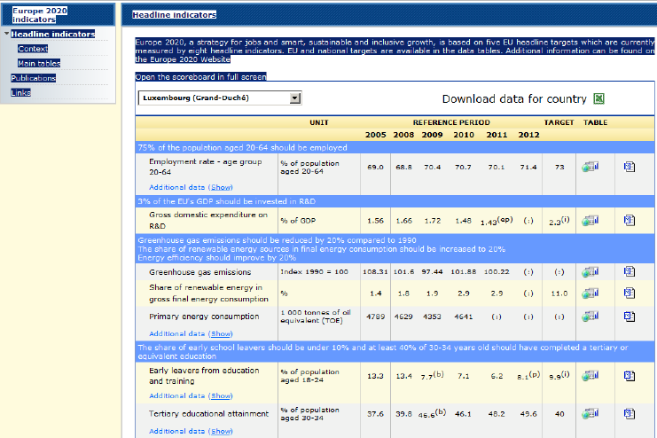
Luxemburg 2020 Hauptindikatoren
Scorecard (Wertungsliste)

Slide 13




New Zealand
Coventry, UK
Kruidenbuurt
Tilburg, Netherlands
Santa Cruz, CA

Slide 14
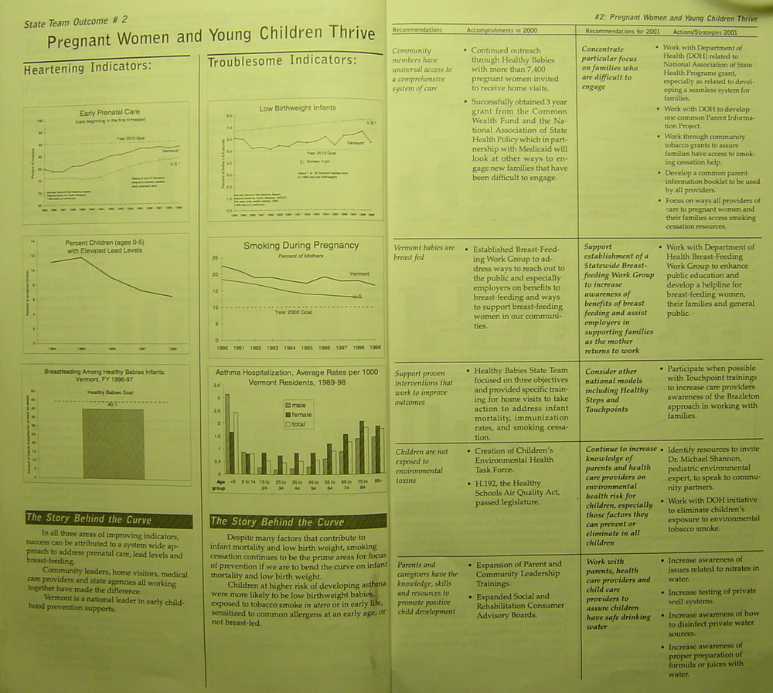

Slide 15
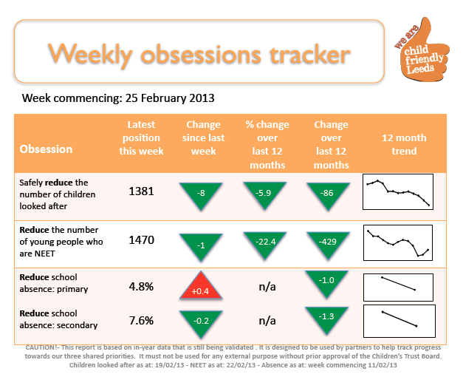

Slide 16
Undichtes Dach
(Ergebnisorientiertes Denken im Alltag)
Erfahrung
Zentimeter Wasserstand
Baseline
Nicht OK
Maßeinheit
? in Ordnung
Die Kurve verändern
Geschichte hinter der Baseline (Gründe)
Partner
Was funktioniert ?
Aktionplan
Notes:
LEAKING ROOF
1. Ask "How many people here have ever had a leaking roof?" (Most hands will go up.)
2. How can you tell if the roof is leaking? ("Water on the floor, down the walls etc.") So, this is how you might "experience" a leaking roof.
3. How could you measure how badly the roof is leaking? ("By how much water...") So you might put out a bucket and measure the number of inches in the bucket after each rainstorm! That's the chart at the right (CLICK): the number of inches from the last three rainstorms.
4. Where do you think this line is headed if we don't do anything? ("It will get worse. Through the roof, you might say.") (CLICK) Draw a forecast line going up. This is the forecast of where we're headed if we don't do anything. We want to turn this curve to zero, right! (CLICK) Draw it.
5. Now, what's the first thing you do when you have a leaking roof? ("You get up on the roof and try to find out why it's leaking.") Right! You look for the cause of the leak. And this is the story behind the Baseline, the causes of why this picture looks the way it does.
6. Who are some of the people who might help you fix the leak? (brother-in-law, neighbor, professional roofer) These are some of your potential partners.
7. Now, what kinds of things work to fix a leak? (Patching material, get a whole new roof, sell the house.) You have some choices about types of patching material. Some will work better than others. Tar is probably better than duct tape.
8. So let's review. You've got a leaking roof. It's getting worse and will keep getting worse unless you do something. You actually have the data on this. You've figured out the cause of the leak and the partners who might help fix it. And you've considered some of the possible ways to fix it. Now the important final question is what are you going to do? This is your action plan.
9. So now you've implemented your action plan. Maybe you've hired a roofer who's gotten up on the roof and patched it. And now what's the next thing you do? ("Wait for the next rainstorm.") Right! You wait for the next rainstorm to see if it's still leaking. And what if it's still leaking, what do you do? (Draw a new point lower but not zero.) ("You get back up on the roof.") Right! You start the whole process over again. You look for causes. You think about who can help and what works. And you try something else - maybe sell the house this time. This is an iterative process. Hopefully you fix the roof in one pass. But the things we are working on are much more complicated than a leaking roof, and one iteration won't do it.
10. So, this is the whole thinking process! It's just common sense. It's how we solve everyday problems. And communities working to improve the quality of life, or managers working to improve their program's performance can use this same process. This is the thinking process at the heart of results and performance decision making! If you understand this process, you can go home now.
11. Notice that we identified the "inches per bucket" measure pretty easily. With a leaking roof, it's obvious what's important and what could be measured. But with programs, agencies and service systems, the choice of what's important and what to measure is much more complex. That's the process that's addressed when we choose indicators or performance measures. (See for Question 3.7 for more information on choosing program, agency or service system performance measures. And see Question 2.7 for more information on the process for choosing indicators for population well-being.)
12. Finally, notice that, in real life, we don't actually put out a bucket and measure the inches of water. We do this work based entirely on the way we experience the leak. We consider it fixed when we don't see water anymore. It is also possible to run the results decision-making processes without data, and use just experience. An action plan can be developed this way. It's a way to get started. But ultimately this is unsatisfying. In complex systems, you generally need data to see if you are making progress or not. Otherwise you are left with just stories and anecdotes. So if you don't have any data at all, you might start the process on the basis of experience. But you should give great attention to pursuing your Data Development Agenda.

Slide 17
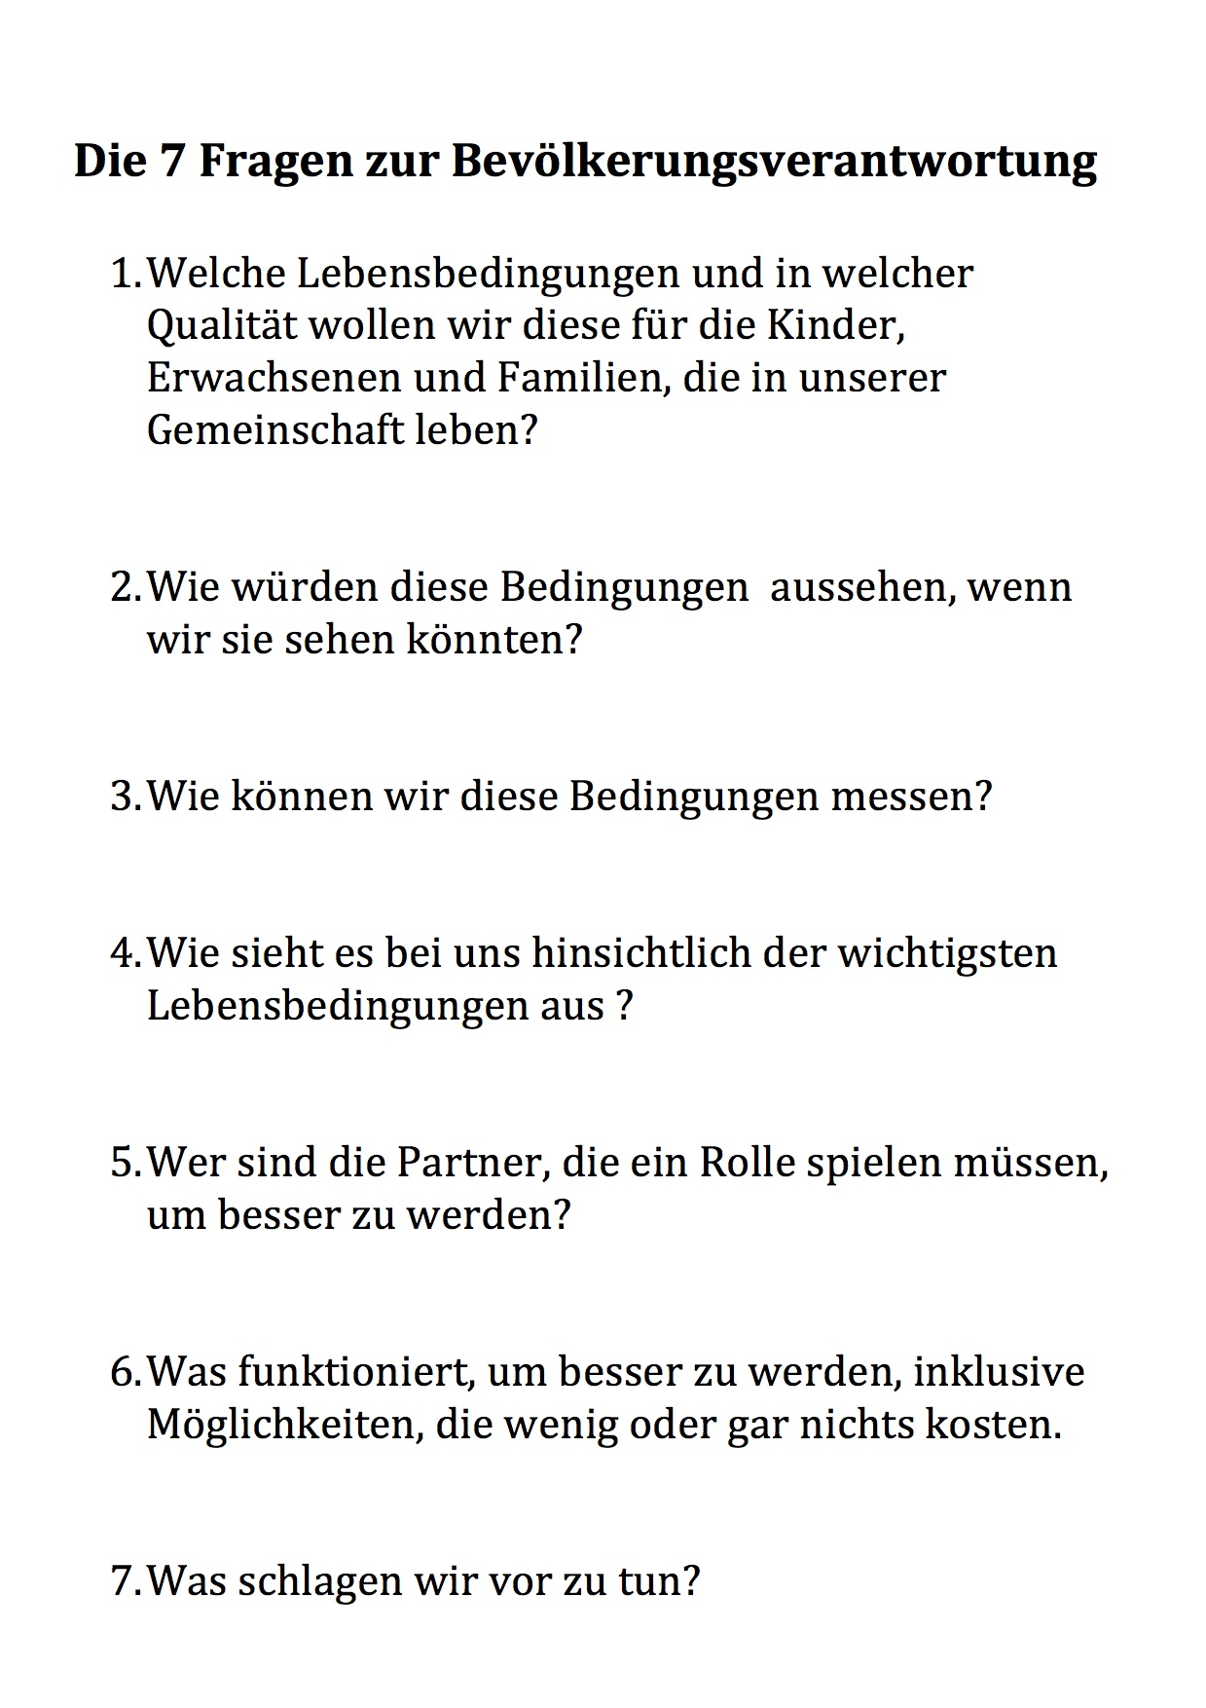

Slide 18
Verkehrstote durch Alkohol
Vereinigte Staaten 1975 bis 2005
75 Personen pro Tag
45 Personen pro Tag
28 Personen pro Tag

Slide 19
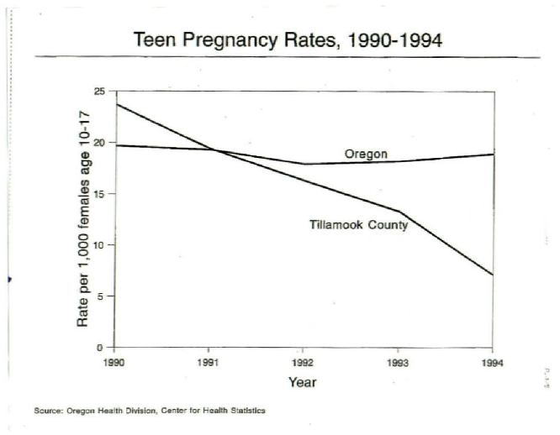
Notes:
Tillamook County was successful in bringing down the teen pregnancy rate, while the rest of Oregon stayed about the same.

Slide 20


Newcastle, UK
Nov 08 – Jan 09
8.5
Revised 9 Nov 2007
Source: Connexions Tyne and Wear, UK
Notes:
This section presents instructions and reporting formats for the two turn the curve exercises, one for population accountability and one for performance accountability. And other exercises

Slide 21
Christchurch, Neuseeland
Anzahl der Graffities
2002 bis 2010

Slide 22
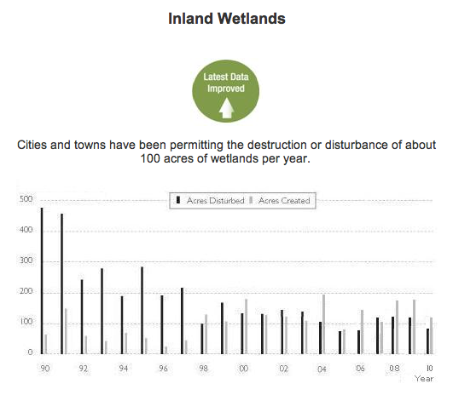
Binnenfeuchtgebiete
Den Städten und Gemeinden wurde die Störung, bzw. Zerstörung von rund 40 Hektar pro Jahr zugestanden

Slide 23
Hull, UK
GESUNDHEIT UND ÖFFENTLICHE SICHERHEIT: WOUNDINGS

Slide 24
LEISTUNGS-
VERANTWORTLICHKEIT
Für Programme, Agenturen und Dienstleister

Slide 25
“Alle Leistungbemessungen, die jemals für irgendeine Dienstleistung in der Geschichte des Universums existiert haben, beinhalten die Antwort auf zwei Arten von miteinender verknüpfter Fragen.”

Slide 26
Leistungsbemessung von Diensten
Quantität
Qualität
Wieviel
haben wir geleistet?
( # )
Wie gut
haben wir das gemacht?
( % )
Notes:
All performance measures can be derived from the cross between two sets of interlocking questions: How much did we do? And How well did we do it?

Slide 27
Leistungsbemessung von Diensten
Einsatz
Wie stark haben wir uns angestrengt?
Effekt
Was hat sich verbessert?
Notes:
Vs. these two dimensions of the work itself: Effort and Effect

Slide 28
Leistungsbemessung von Diensten
Einsatz
Wie-
viel
Wie
gut
Effekt

Slide 29
Leistungsbemessung von Programmen
Quantität
Qualität
Wieviel haben wir geleistet?
Wie gut haben wir es gemacht?
Effekt Einsatz
Hat sich etwas verbessert?
Anzahl (#)
%
Notes:
Or an even simpler construction: How much did we do? How well did we do it? Is anyone better off?

Slide 30
BILDUNG
Quantität
Qualität
Wieviel haben wir geleistet?
Wie gut haben wir es gemacht?
Zahl der Studenten
Studenten-Lehrer Verhältnis
Effekt Einsatz
Hat sich etwas verbessert?
Anzahl der 16 Jährigen mit sehr gut bis befriedigen
beim Realschulabchluss
Anzahl mit guter Schulanwesenheit
% der 16 Jährigen mit sehr gut bis befriedigend
beim Realschulabschluss
Prozent mit guter Schulanwesenheit
Notes:
Or an even simpler construction: How much did we do? How well did we do it? Is anyone better off?

Slide 31
Drogen/Alkohol Programm
Wieviel haben wir geleistet?
Wie gut haben wir es gemacht?
Anzahl der behandelten Personen
Kosteneinheit pro Behandlung
Hat sich etwas verbessert?
Anzahl der Patienten, die von Alkohol/Drogen entwöht sind - bei der Entlassung
- 12 Monate nach der
Entlassung
Prozent der Patienten, die von Alkohol/Drogen entwöhnt sind - bei der Entlassung
- 12 Monate nach der
Entlassung
Notes:
Examples of measures for a typical drug and alcohol treatment program.

Slide 32
SERVICE FÜR ABFALL-MANAGEMENT
Quantität
Qualität
Wieviel haben wir geleistet?
Wie gut haben wir es gemacht?
Anzahl der Tonnen an Haushaltsmüll
Kosteneinheit pro gesammelter Tonne
Effekt Einsatz
Hat sich etwas verbessert?
LKW-Ladungen auf die Deponie
LKW-Ladungen recycelt
% zur Deponie
% recycelt
Notes:
Or an even simpler construction: How much did we do? How well did we do it? Is anyone better off?

Slide 33
KOMMERZIELLER TOURISMUS
Quantität
Qualität
Wieviel haben wir geleistet?
Wie gut haben wir es gemacht?
Anzahl des versandten Informationspakete
Kosteneinheit pro Informationspaket
Effekt Einsatz
Hat sich etwas verbessert?
Anzahl der Touristen
Marktanteil des Tourismus
Notes:
Or an even simpler construction: How much did we do? How well did we do it? Is anyone better off?

Slide 34
Feuerwehr
Quantität
Qualität
Wieviel haben wir geleistet?
Wie gut haben wir es gemacht?
Anzahl der Einsätze
Zeitraum bis zum Einsatz
Effekt Einsatz
Hat sich etwas verbessert?
Anzahl der Feuer, die auf den Ausbruchsort beschränkt blieben
% der Feuer, die auf den Ausbruchsort beschränkt blieben
Notes:
Or an even simpler construction: How much did we do? How well did we do it? Is anyone better off?

Slide 35
General Motors
Quantität
Qualität
Wieviel haben wir gemacht?
Wie gut haben wir es gemacht?
# Anzahl Produktionsstunden
# Anzahl Tonnen Stahl
Angestellte pro produziertem Auto
Effekt Einsatz
Hat sich jemand/etwas verbessert?
# Anzahl verkaufter Autos
€ Gewinnbetrag
€ Wert des Autos nach 2 Jahren
% Marktanteil
Gewinn pro Anteil
% Wert des Autos nach 2 Jahren
Notes:
Or an even simpler construction: How much did we do? How well did we do it? Is anyone better off?

Slide 36
Nicht alle Leistungsmaße werden gleichermaßen erstellt
Quantiät
Qualität
Wieviel haben wir geleistet?
Wie gut haben wir es gemacht?
Am wenigsten
wichtig
Auch sehr
wichtig
Effekt Einsatz
Hat sich etwas verbessert?
Am Wichtigsten
Notes:
So why sort measure for your program into these categories?
Simple. These categories are not equally important. The upper left is the least important. And yet we have some people who spend their whole careers living in this quadrant counting cases and activity. Somehow we have to push the discussion to the lower right quadrant, the one that measures whether our customers are better off.

Slide 37
Eine Frage der Kontrolle
Quantität
Qualität
Wieviel haben wir geleistet?
Wie gut haben wir es gemacht?
Am meisten Kontrolle
Effekt Einsatz
Hat sich etwas verbessert?
Am wenigsten
Kontrolle
PARTNERSCHAFTEN
Notes:
As you move from the least important measures to the most important measures, you go from having the most control to having the least control. And this is another reason why people spend their whole lives in the upper left quadrant. Fear. It can be scary to look at the data in the lower right quadrant. But ask people why they went into their profession and the answers all lie in the lower right, in the ways in which we try to make our customer’s lives better.

Slide 38
Leistungsverantwortlichkeit
Typen von Bemessungen für jeden Quadranten
Wieviel haben wir geleistet?
Wie gut haben wir es gemacht?
% Allgemeine Bemessungen
# Patienten/Kunden bedient
z.B.. Patienten-Personal Verhältnis, Arbeitsbelastungsverhältnis, Personal turnover Rate, Personalmoral, % Personal vollständig fortgebildet, % der Patienten in ihrer Muttersprache bedient,
Arbeitssicherheit Kosten prp Einheit
# Aktivitäten (pro Art der Aktivität)
% Aktivitäts-spezifische Bemessungen
z.B.% rechtzeitig, % Patienten mit abgeschlossener Aktivität, % korrekt und vollständig, % entspricht dem Standard
Hat sich etwas verbessert?
#
% Fähigkeiten / Wissen
(z.B. Fähigkeiten als Eltern)
Zeitpunkt
gegenüber
2 Punkte Vergleich
#
% Einstellung/Meinung
(z.B.gegenüber Drogen)
#
% Verhalten
(z.B. Schulbesuch)
#
% Rahmenbedingungen
(z.B. Arbeit, gute Wohnverhältnisse)
Notes:
This chart shows in detail the different types of measure we typically find in each quadrant, and the measures that go with the three basic categories of performance measurement:
How much did we do?
How well did we do it?
Is anyone better off?
In the upper left, How much did we do? Quadrant, we typically count customers and activities.
In the upper right, How well did we do it? Quadrant, there are a set of common measures that apply to many different programs. And there is a set of activity specific measures. For each activity in the upper left, there is one or more measures that tell how well that particular activity was performed, usually having to do with timeliness or correctness.
In the lower quadrants, Is anyone better off? We usually have # and % pairs of the same measure. And these measures usually have to do with one of these four dimensions of better-offness: Skills/knowledge, Attitude, Behavior and Circumstance.
For each of these measures, we can use point in time measures or point to point improvement measures.

Slide 39
Dienstleistung: __________________________________
Krankenhaus
Berufsausbildung
Schule
Feuerwehr
Wieviel haben wir geleistet?
Wie gut haben wir es gemacht?
Primary customers
Unit cost
#
Students/patients/
persons trained
Workload ratio
Primary activity
% of ___x___ that happen on time
#
hours of instruction
diagnostic tests
job courses
alarms responded to
Was hat sich verbessert?
If your service works really well,
how are your customer's better off?
#
%
students who graduate
patients who fully recover
persons who get jobs
fires kept to room of origin
Notes:
This chart shows in detail the different types of measure we typically find in each quadrant, and the measures that go with the three basic categories of performance measurement:
How much did we do?
How well did we do it?
Is anyone better off?
In the upper left, How much did we do? Quadrant, we typically count customers and activities.
In the upper right, How well did we do it? Quadrant, there are a set of common measures that apply to many different programs. And there is a set of activity specific measures. For each activity in the upper left, there is one or more measures that tell how well that particular activity was performed, usually having to do with timeliness or correctness.
In the lower quadrants, Is anyone better off? We usually have # and % pairs of the same measure. And these measures usually have to do with one of these four dimensions of better-offness: Skills/knowledge, Attitude, Behavior and Circumstance.
For each of these measures, we can use point in time measures or point to point improvement measures.

Slide 40
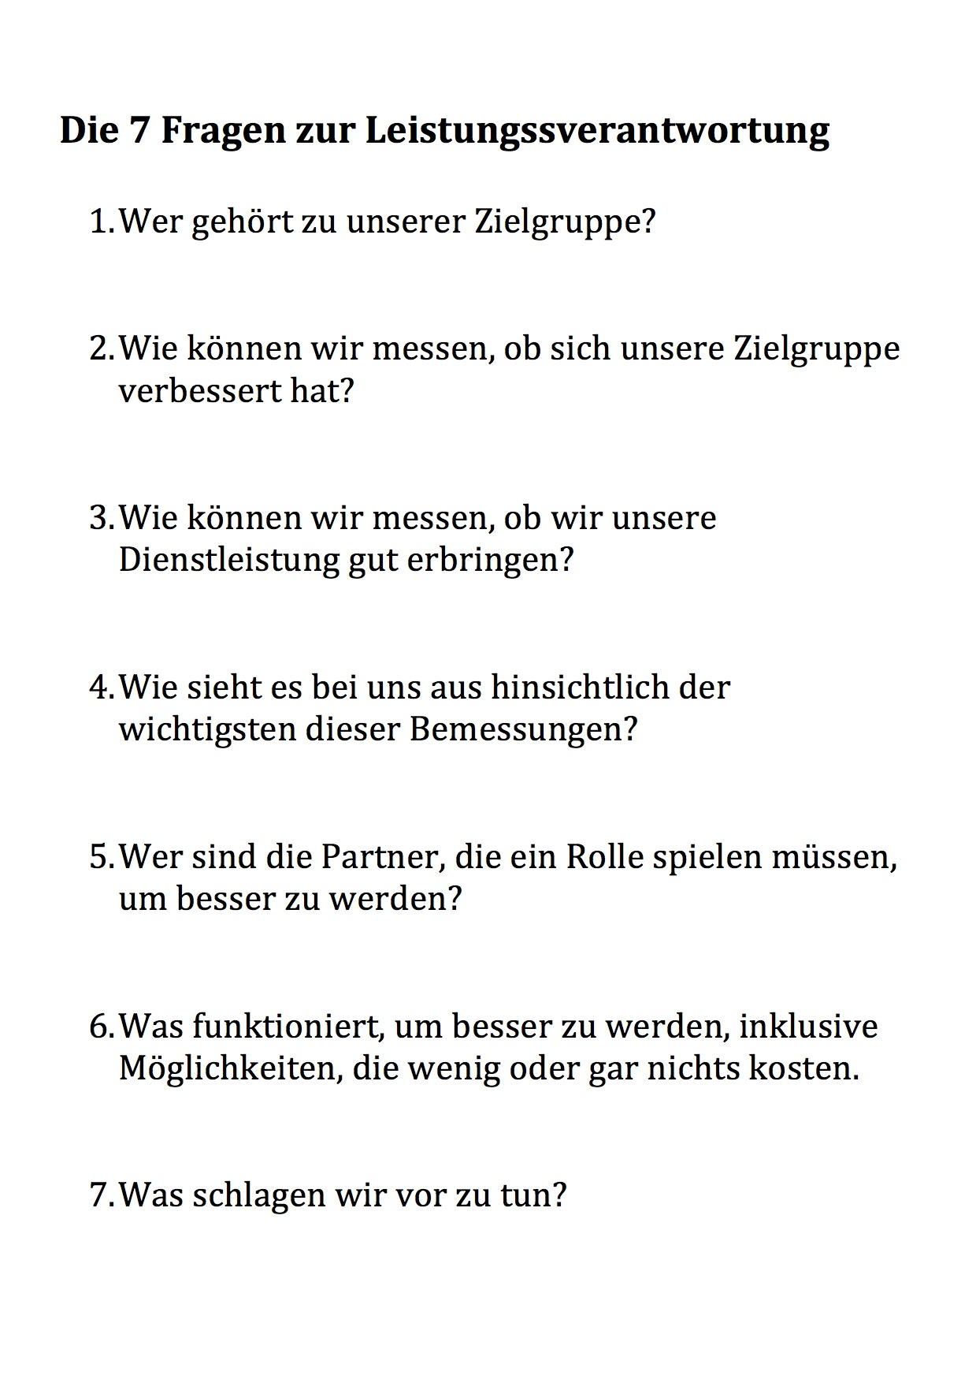
Primär gegenüber Sekundär
UR (unten rechts)
Direkt gegenüber Indirekt
OR (oben rechts)
Intern gegenüber Extern
Baseline & Geschichte
Notes:
Here is the thinking process in the form of 7 plain language common sense questions.
These questions should be asked an answered periodically (monthly, quarterly) at every intersection of supervision from the top to the bottom of the organization.
This is the most important take-away page for performance measurement. It can be used immediately without any further training.

Slide 41
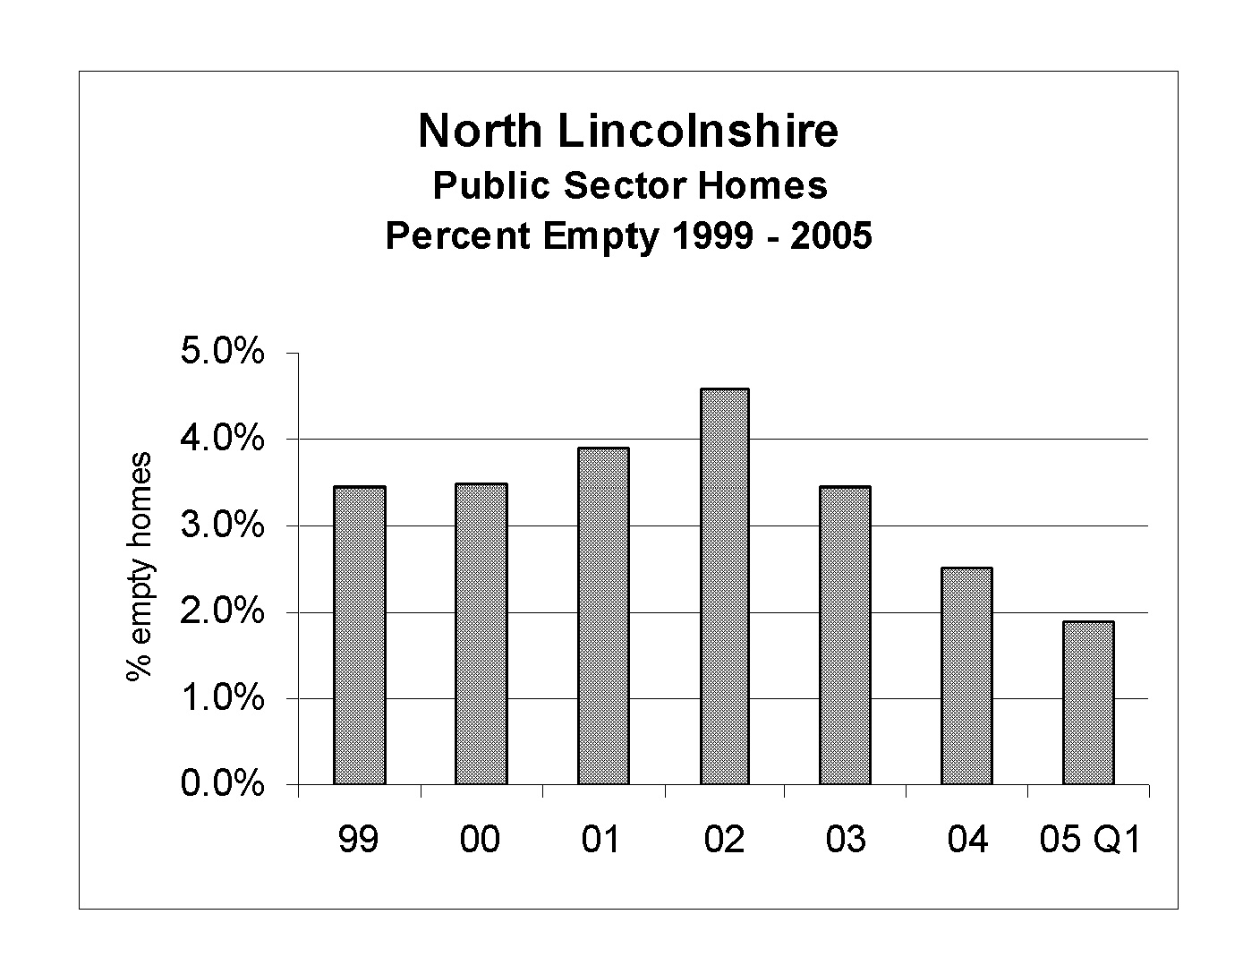
Öffentlicher Wohnungsbau
Prozent Leerstand 1999-2005

Slide 42
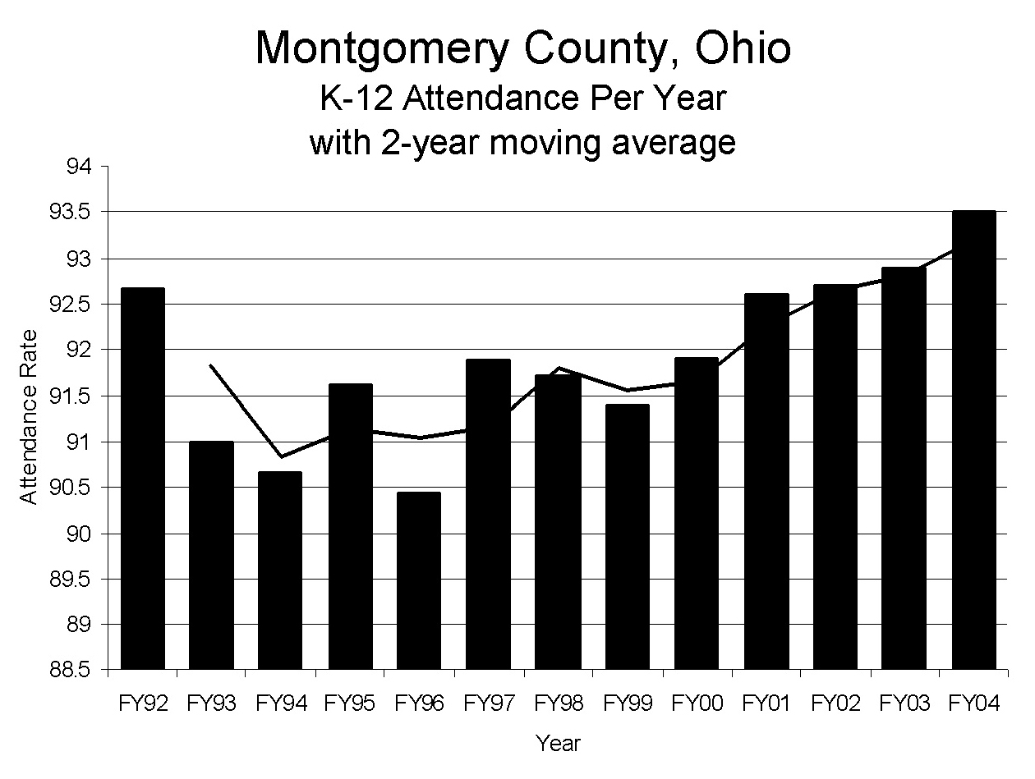
K-12 Teilnahme pro Jahr mit einem Durchschnitt von ?????????

Slide 43
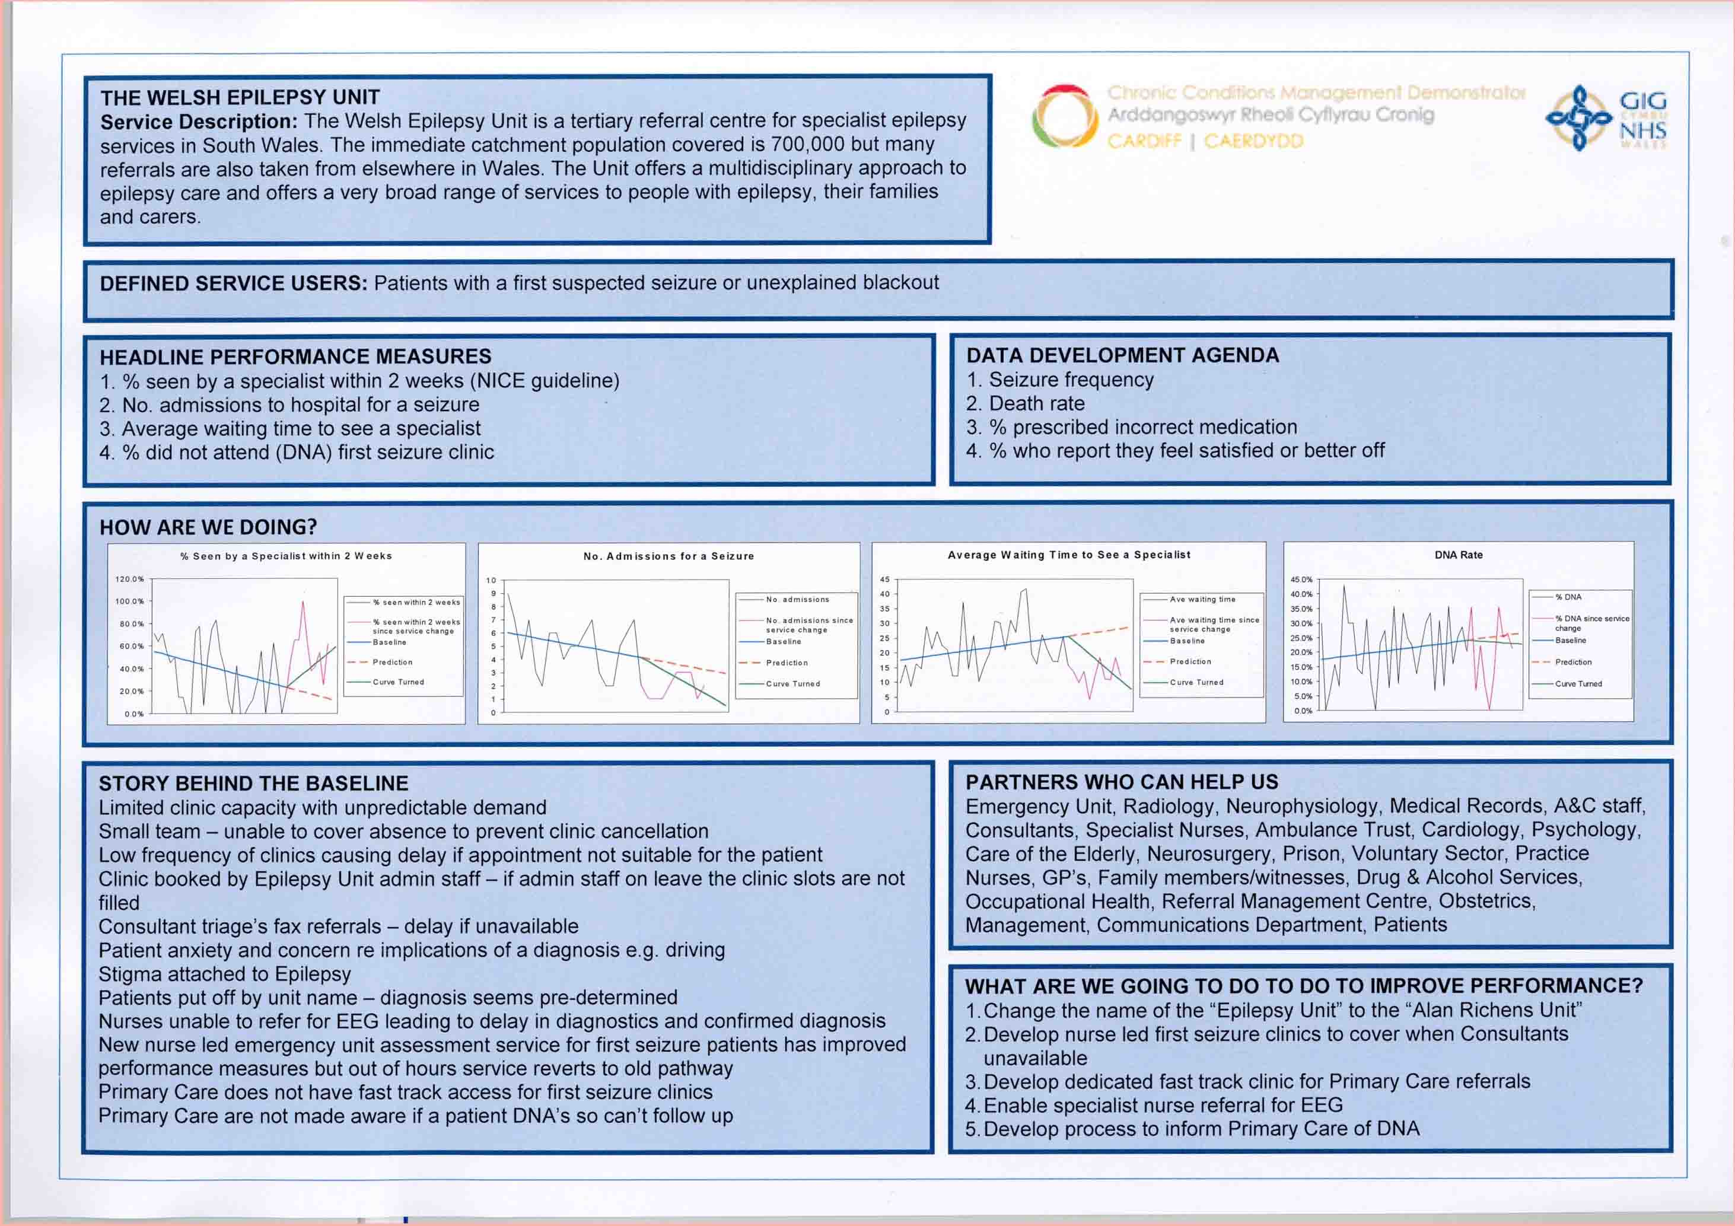

Slide 44
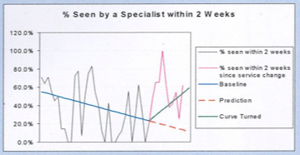
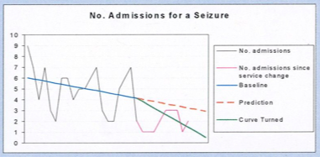
Notes:
Welsh Epilepsy Unit case study was also posted on the same page and that's the one showing benefits such as:"
• The average length of time from seizure to a confirmed diagnosis has decreased by 81 days from 111 days to 30 days
• The number of patients who have been seen by a specialist within the NICE guideline of two weeks has increased from 35% to 61%
• The average waiting time to see a specialist has decreased from 22 days to 11 days
• The number of admissions following a seizure have decreased from 5 a month to 2 a month on average"

Slide 45
Wasserrohrbrüche pro Jahr
London Ontario

Slide 46
Wie Bevölkerungs-
&
Leistungs- verantwortlichkeit
ZUSAMMENPASSEN
Notes:
We’ve talked about two different kinds of accountability. Now let’s look at how they fit together.

Slide 47
Die Verbindung zwischen BEVÖLKERUNG und LEISTUNG
BEVÖLKERUNGSVERANTWORTLICHKEIT
BEVÖLKERUNGS-
ERGEBNISSE
Gesunde Geburten
Anzahl von Babies mit niedrigem Geburtsgewicht
Stabile Familien
Anzahl von Kindesmißbrauch und Vernachlässigung
Schulreife Kinder
Prozentsatz schulreif nach Schulreife-Prüfung
Leistet einen Beitrag
LEISTUNGSVERANTWORTLICHKEIT
Abgleich der Maßnahmen
Kinderhilfs-Programm
% initiiert innerhalb von 24 Std. nach Benachrichtigung
# von Untersuchungen getätigt
Angemessene
Verantwortlichkeit
# Wiederholung Mißbrauch/Vernachlässigung
% Wiederholung Mißbrauch/Vernachlässigung
ZIELGRUPPEN-
ERGEBNISSE
Notes:
The relationship is a “contribution” relationship, not a cause and effect relationship. What we do for our customers is our contribution to what we and our partners are trying to do across the community.
Often the only difference between a population indicator and a lower right (Is anyone better off?) performance measure is the difference in scale between a client population and the total population.
This allows us to think about how our work is aligned with what we are trying to accomplish across the community. It allows us to think about how the measures we use at the program level relate to those at the population level. And it allows us to avoid the trap of holding programs responsible for population level change. We can hold program responsible for what they do for their clients. We must hold ourselves, across the community, responsible for the well being of the population.

Slide 48
Bevölkerungsverantwortlichkeit
Ergebnis:zu welchem Sie am direktesten beigetragen haben.
Indikatoren:
Jedes mal
wenn Sie Ihr Programm präsentieren,
verwenden Sie eine zweiteilige Dartstellung.
Geschichte:
Partner:
Was bräuchte es?:
Ihre Rolle
Ihre Rolle: als Teil einer größeren Strategie.
Leistungsverantwortlichkeit
Programm:
Leistungsbemessung:
Geschichte:
Partner:
Aktionsplan um besser zu werden:
Notes:
Budgets of the future will have two parts:
Volume I will present a picture of quality of life results and indicators and what is being done by government and its partners to improve.
Volume II will present performance measures for departments and programs.
Both will use the Baseline, Story, What Works and Strategy format shown above.
This is a fractal… the same pattern at every level of magnification.

Slide 49
Verschiedene Arten von Fortschritt
1. Daten
a. Bevölkerungsindikatoren Tatsächlich veränderte Kurven:
Bewegung von der Baseline weg, hin zum Besseren.
b. Dienstleistungsbemessung:
Fortschritt für die Zielgruppe und bessere Dienstleistung:
Wieviel haben wir geleistet?
Wie gut haben wir es gemacht?
Hat sich etwas verbessert?
2. Besondere Errungenschaften: Positive Aktivitäten, die oben nicht enthalten sind.
3. Anekdoten: Geschichten hinter den Statistiken, die zeigen inwiefern sich etwas konkret verbessert hat.
Notes:
There are four kinds of progress which can be reported. The first at the population level, and 2 3 and 4 at the program agency or service system level.

Slide 50
Treffen des Direktoriums
AGENDA
1. Neue Daten
1. Neue Daten
2. Neue Geschichte hinter der Kurve
2. Neue Geschichte hinter der Kurve
3. Neue Partner
3. Neue Partner
4. Neue Information darüber, was funktioniert.
4. Neue Information darüber, was funktioniert.
5. Neue Information zur Finanzierung
5. Neue Information zur Finanzierung
6. Änderungen am Aktionplan und Budget
7.
7. Vertagt
Notes:
Community collaborative groups and programs and agencies could use this as the agenda for their meetings. The meeting would be aligned with the thinking process that produced the action plan. Each iteration of this thinking process will improve the action plan.

Slide 51
ZU GUTER LETZT…

Slide 52
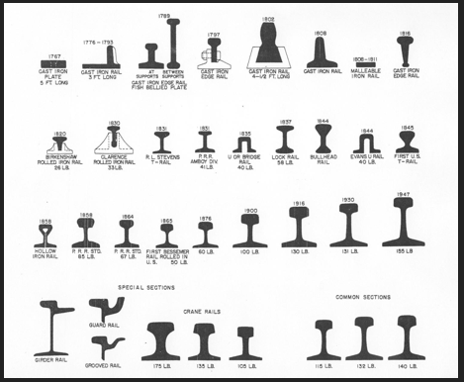

Slide 53
EOV in aller Kürze
2 – 3 - 7
2 – Arten von Verantwortlichkeit
Bevölkerungsverantlichkeit
Leistungsverantwortlichkeit
plus Sprachdisziplin
Ergebnisse & Indikatoren
Leistungsbemessungen
3 – Arten von Leistungsbemessungen.
Wieviel haben wir geleistet?
Wie gut haben wir es gemacht?
Hat sich etwas verbessert?
7 – Fragen vom Zweck hin zu den Mitteln in weniger als einer Stunde.
Baselines & Die Kurve verändern

Slide 54
Informationsmaterial
www.raguide.org
www.resultsaccountability.com
RBA Facebook Group
Book - DVD Orders
amazon.com
resultsleadership.org

Slide 55
Vielen Dank!
Websites
raguide.org
resultsaccountability.com
Bücher – DVD Bestellung
amazon.com
resultsleadership.org

Slide 56
Übung zur Veränderung der Kurve

Slide 57
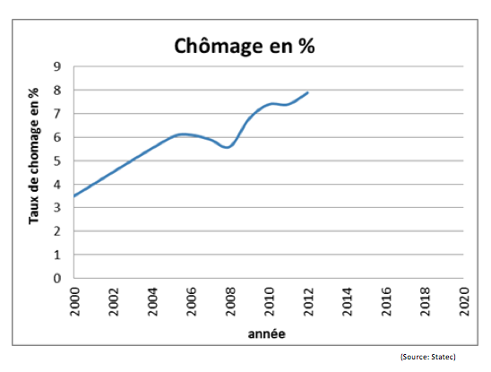
Arbeitslosigkeit

Slide 58
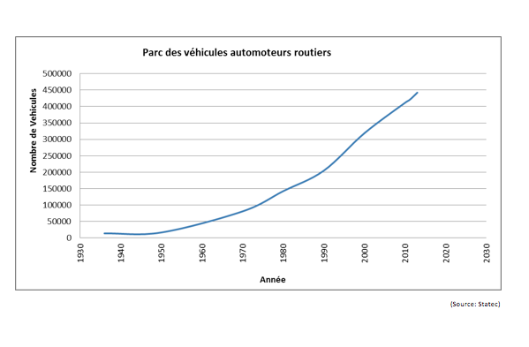
# Anzahl der in Luxemburg registrierten Autos

Slide 59
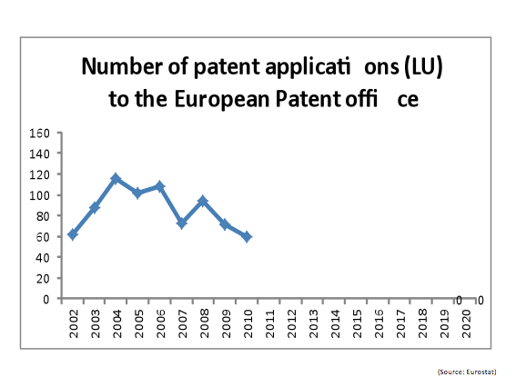
# Anzahl Patentanträge aus LU beim EU Patentamt

Slide 60
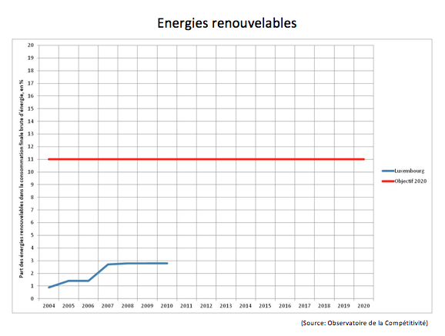
% Erneuerbare Energie

Slide 61
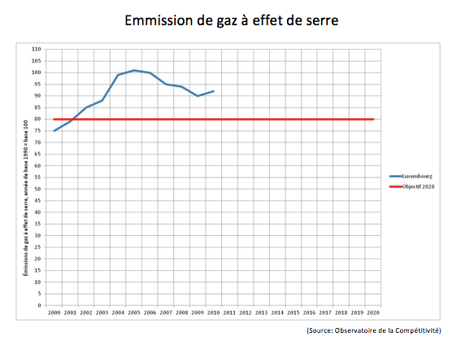
Rate der CO2 Emission

Slide 62
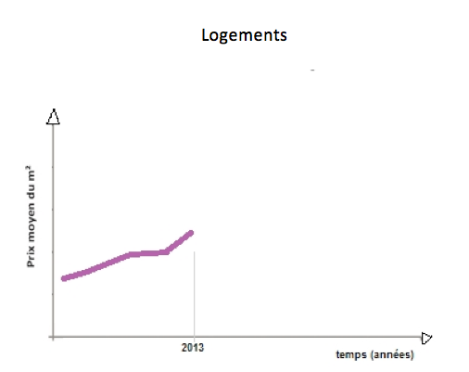
Quadratmeter Preise im Wohnungsbau

Slide 63
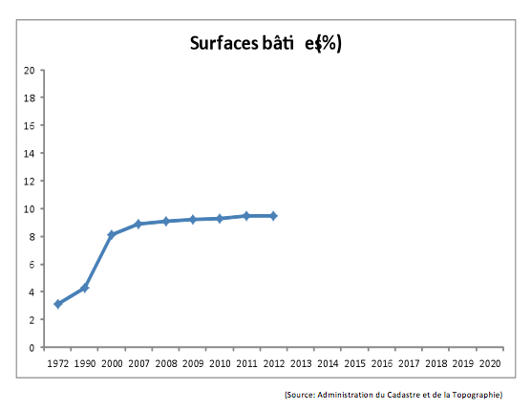
% Bebaute Fläche (LU)

Slide 64
Entwicklung einer Baseline zu Arbeitszwecken
durch Gruppenwissen
% mit gutem Realschulabschluss
60%
Nicht OK?
Vorhersage
Rückwärtsprojektion
Jetzt

Slide 65
Übung zur Veränderung der Kurve : Bevölkerung
5 min: Ausgangspunkte
- Zeitgeber und Berichterstatter
- geographischer Raum
- zwei Hüte (Ihrer plus der eines Partners)
10 min: Baseline
- wählen Sie ein Bevölkerungsergebnis, und eine Indikatorenkurve zum Verändern
- Vorhersage bis 2016 – OK oder nicht OK?
15 min: Geschichte zur Baseline
- Gründe/Kräfte die wirken
- Information & Forschungsagenda Teil 1 - Gründe
Zwei Hinweise für
Aktivitäten
15 min: Was funktioniert? (Was bräuchte es?)
- was könnte funktionieren, um es besser zu machen?
- Beitrag eines jeden Partners
- keine Kosten/ geringe Kosten Ideen
- Information & Forschungsagenda Teil 2 – was funktioniert
10 min: Bericht Notizen auf einer Seite zusammenfassen
Notes:
Participant instructions for the population turn the curve exercise.

Slide 66
EINE SEITE Bericht zur Veränderung der Kurve: Bevölkerung
Bevölkerungsergebnis: _______________
Indikator
(Laiendefinition)
Indikator
Baseline
Geschichte hinter der Baseline
---------------------------
--------------------------- (soviele auflisten wie nötig)
Partner ---------------------------
--------------------------- (soviele auflisten wie nötig)
Die drei besten Ideen – was funktioniert
1. ---------------------------
2. ---------------------------
3. ---------keine Kosten/ geringe Kosten
KonkreteIdeen
4. --------- verrückt
Notes:
Group report out format for the performance turn the curve exercise.

Slide 67
Übung zur Veränderung der Kurve: Service Leistung
5 min: Ausgangspunkte
- Zeitgeber und Berichterstatter
- wählen Sie ein Programm/Dienstleistung
- zwei Hüte (Ihrer plus der eines Partners)
10 min: Baseline zur Leistungsbemessung
- wählen Sie eine Leitungsbemessung – aus dem unteren rechten Quadranten
- Vorhersage bis 2016 – OK oder nicht OK?
15 min: Geschichte zur Baseline
- Gründe/Kräfte die wirken
- Information & Forschungsagenda Teil 1 - Gründe
Zwei Hinweise für
Aktivitäten
15 min: Was funktioniert? (Was bräuchte es?)
- was könnte funktionieren, um es besser zu machen?
- Beitrag eines jeden Partners
- keine Kosten/ geringe Kosten Ideen
- Information & Forschungsagenda Teil 2 – was funktioniert
10 min: Bericht Notizen auf einer Seite zusammenfassen
Notes:
Participant instructions for the population turn the curve exercise.

Slide 68
EINE SEITE Bericht zur Veränderung der Kurve: Leistung
Programm/Dienstleistung: _______________
Leistungbemessung
(Laiendefinition)
Leistungs-
bemessung
Baseline
Geschichte hinter der Baseline
---------------------------
--------------------------- (soviele auflisten wie nötig)
Partner ---------------------------
--------------------------- (soviele auflisten wie nötig)
Die drei besten Ideen – was funktioniert
1. ---------------------------
2. ---------------------------
3. ---------keine Kosten/ geringe Kosten
KonkreteIdeen
4. --------- verrückt
Notes:
Group report out format for the performance turn the curve exercise.

Slide 69
Übung zur Veränderung der Kurve – gelernte Lektionen
Vom Wort zur Tat in einer Stunde
1. Wie hat sich das von anderen Prozessen unterschieden?
Was hat funktioniert und was nicht?
2. Warum haben wir nachgefragt nach:
a. Ergebnissen vor Indikatoren?
b.Vorhersage?
c. Geschichte?
d. Keine Kosten / Wenig kosten?
e. Zwei Hüte?
f. Verrückte Idee?
g. Nur die 3 besten Ideen?
3. Glauben Sie ein Laienpublikum könnte den Bericht verstehen?
4. Wieviel glauben, daß sie diese Übung mit einer kleinen Gruppe
anleiten könnten ?(2+ Kurven zur gleichen Zeit)

Slide 70
Vergleichsweise mildeste Kürzung

Slide 71
EOV - Übung 1 zur vergleichsweise mildesten Kürzung: BEVÖLKERUNG
Vergleichsweise geringster Nachteil für die Lebensqualität der Bevölkerung (Bevölkerungsverantwortlichkeit)
1. Identifizieren Sie ein Bevölkerungsergebnis zu dem Ihre Organisation am direktesten
beiträgt (z.B. Gesunde Bevölkerung, Nachhaltige Umwelt, Schulfreife Kinder)
2. Was ist die Rolle Ihrer Organisation hinsichtlich des Beitrages zu diesem Ergebnis?
3. Was tun Sie, das den größten Beitrag leistet?
4. Was tun Sie, das den geringsten Beitrag leistet? (Kandidat für die vergleichsweise
mildeste Kürzung)
5. Wie würden Sie die Art, wie Sie Ihre Arbeit tun ändern, um den gleichen oder beinahe
den gleichen Beitrag mit weniger Ressourcen zu leisten? (Kandidat für die
vergleichsweise mildeste Kürzung)
- Zeit: 5 Minuten für jede Frage
- Schreiben Sie die Antworten zu jeder Frage auf
- Berichten Sie die 3 besten Ideen und Ihre Gründe

Slide 72
EOV – Übung 2 zur vergleichsweise mildesten Kürzung: LEISTUNG
Vergleichsweise geringster Nachteil für die Lebensqualität der Zielgruppen (Leistungsverantwortlichkeit)
1. Identifizieren Sie eine Dienstleistung.
2. Identifizieren Sie die wichtigste Zielgruppe.
3. Was tun Sie, was das Leben Ihrer Zielgruppe am effektivsten verbessert?
4. Was ist am wenigsten effektiv? (Kandidat für die vergleichsweise
mildeste Kürzung)
5. Wie würden Sie die Art, wie Sie Ihre Arbeit tun ändern, um den gleichen oder beinahe
den gleichen Beitrag mit weniger Ressourcen zu leisten? (Kandidat für die
vergleichsweise mildeste Kürzung)
- Zeit: 5 Minuten für jede Frage
- Schreiben Sie die Antworten zu jeder Frage auf
- Berichten Sie die 3 besten Ideen und Ihre Gründe

Slide 73
Wie geht es weiter?
Ein einfacher Aktionsplan für Ergebnisorientierte Verantwortlichkeit
SCHIENE 1: BEVÖLKERUNGSVERANTWORTLICHKEIT
● Bestimmen Sie Bevölkerungsergebnisse.
● Führen Sie Indikatoren, Baselines und Grafiken an der Wand ein.
● Erstellen Sie Berichtskarten für Indikatoren.
● Organisieren Sie Tische (Aktionsgruppen) zum “Kurven verändern”.
SCHIENE 2: LEISTUNGSVERANTWORTLICHKEIT
● Leistungsbemessungen und Grafiken an der Wand, für Programme,
Agenturen, und Dienstleister.
● Verwenden Sie die 7 Fragen, Abteilungsleiter für Abteilungsleiter und
Programm für Programm beim Managen, Budgetaufstellen und bei
der Strategischen Planung.
Notes:
Implementation of results and performance accountability should proceed along three parallel tracks.

Slide 74
Nächste Schritte:
1. Was ist eine Sache, die ich persönlich mit dem anfangen könnte, was ich heute gelernt habe?
2. Was ist eine Sache, die ich gerne bei jemand anderem oder einer Organisation anfragen würde,um diese Arbeit zu unterstützen?

Slide 75
VIELEN DANK!
Book - DVD Orders
amazon.com
resultsleadership.org

